Slide 1
Capstone - Analysis of Filipino Venues in Los Angeles
Identifying the Ideal Locations a for New Filipino Chain-Restaurant

Slide 2
Business Problem
Los Angeles, California is one of the most populated and highly diverse cities in the United States, with the metropolitan population ~13.1 million.
Los Angeles is the second-leading area in the world with the highest population of Filipinos. Filipino cuisine is also becoming more popular in the United States.
A new entrepreneur is interested in opening up several Filipino dine-in chain restaurants in Los Angeles based on the population and possible demand for new Filipino restaurants in this area.

Slide 3
Data Acquisition and Cleaning
We will be pulling data from the following sources:
Geospatial data of Los Angeles county of neighborhoods and cities - from Los Angeles Times website
Filipino Restaurant/Venue data from Foursquare API
There are 318 neighborhoods total from the Los Angeles geospatial data
Removed any categories from venue data that were not related to our analysis
28 Venues were identified from the Foursquare API for analysis after data cleansing

Slide 4
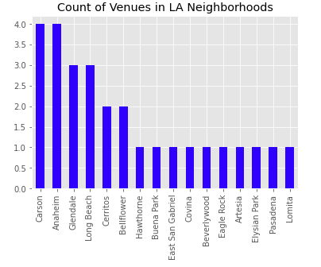
Frequency -
Chart for each neighborhood and number of Filipino venues

Slide 5
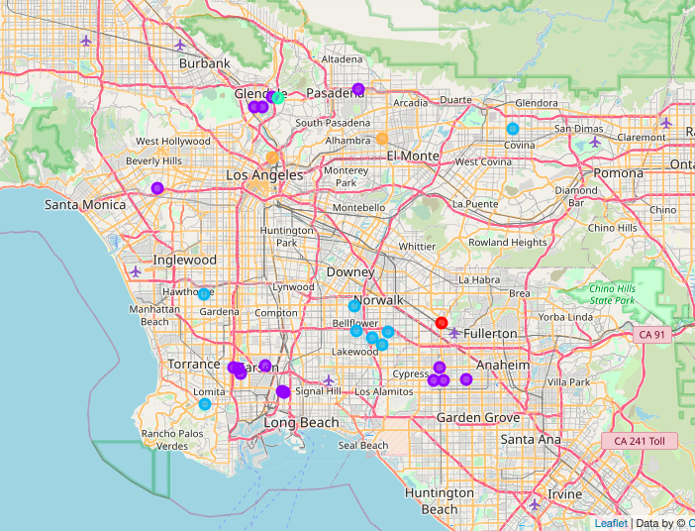
Map of Los Angeles with 5 Clusters and locations of venues within each cluster

Slide 6
K-means Clustering
5 Clusters were identified based on the 28 venues.
Cluster 0: Asian Restaurant Presence
Cluster 1: Restaurants, Bakeries and Markets
Cluster 2: Filipino Restaurants
Cluster 3: Filipino Outdoor Event space
Cluster 4: Filipino Food Trucks

Slide 7
Discussions and Conclusion
Clusters 3 and 4 already have Filipino food/venue presence, but do not have a dine-in Filipino restaurant experience. (Cluster 4 is in neighborhoods East San Gabriel and Elysian Park. Cluster 3 is in Eagle Rock).
Cluster 4, Elysian Park, is very close to downtown LA. This would be an ideal place for a chain restaurant.
Cluster 3, Eagle Rock, is nearby Glendale - which also has a strong Filipino venue presence. This would also be an ideal location for a chain filipino restaurant.
Could include other features, such as population of neighborhoods to identify which neighborhoods are more densely populated

